Slide 1

PREDICTING SAFETY FOR TRAVELLING
CAPSTONE PROJECT

Slide 2
A LITTLE ABOUT ME – I LOVE TO TRAVEL
But, planning?
Hundreds, or even thousands of different sites to research on
Months of preparation
How prepared must I be in a foreign country?
This solution would be for
travellers who wants to stay safe while having fun
people who are moving to a new neighbourhood and wants to know the vicinity a little better

Slide 3
Let’s use Toronto, canada as an example of the place I am travelling to

Slide 4
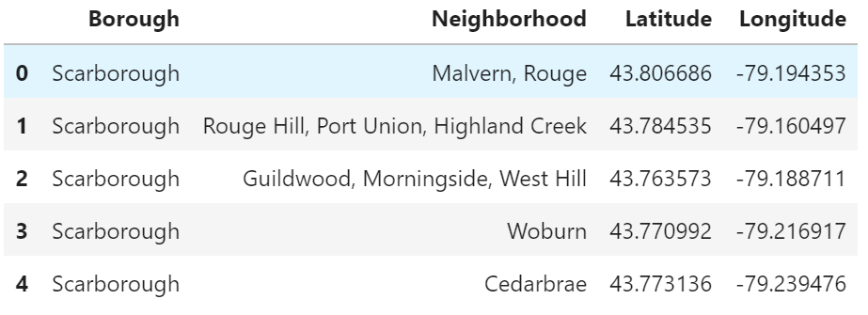
Toronto data set
Scrapping postal codes data from Wikipedia
Using data given by IBM in week 3

Slide 5
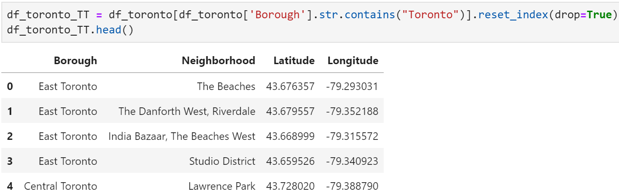
Redefine data
Filtering out borough that contains the word Toronto
Data now only contains borough from East, West, Central and Downtown Toronto

Slide 6
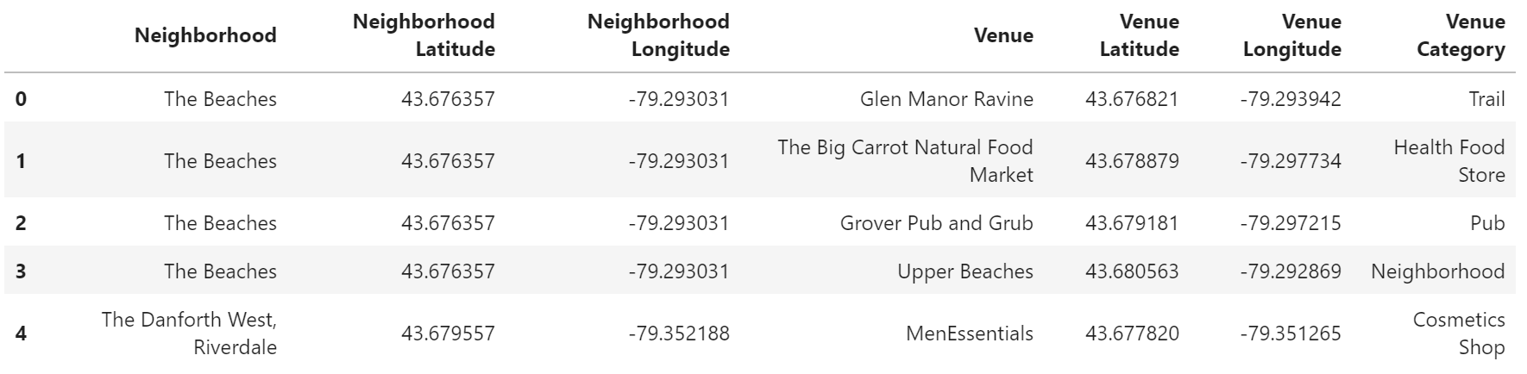
Getting venues nearby
Using the getnearby venue function to find all the nearby neighborhood venues

Slide 7
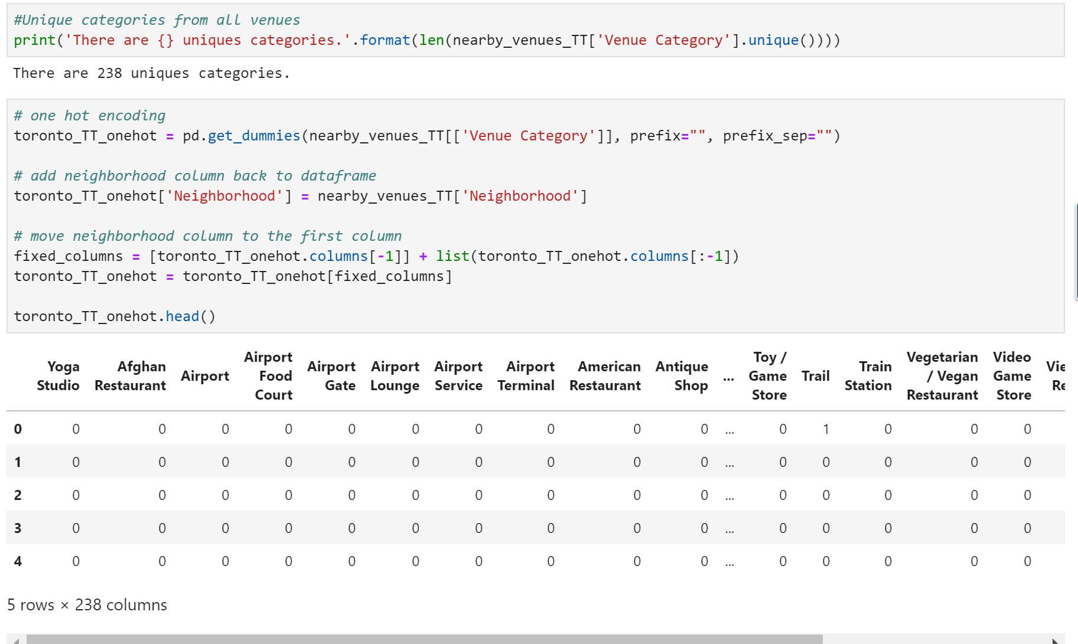
One hot encoding
There are 238 different categories of venues we have nearby
Finding the probability of the venues to determine the top few venues in the area

Slide 8
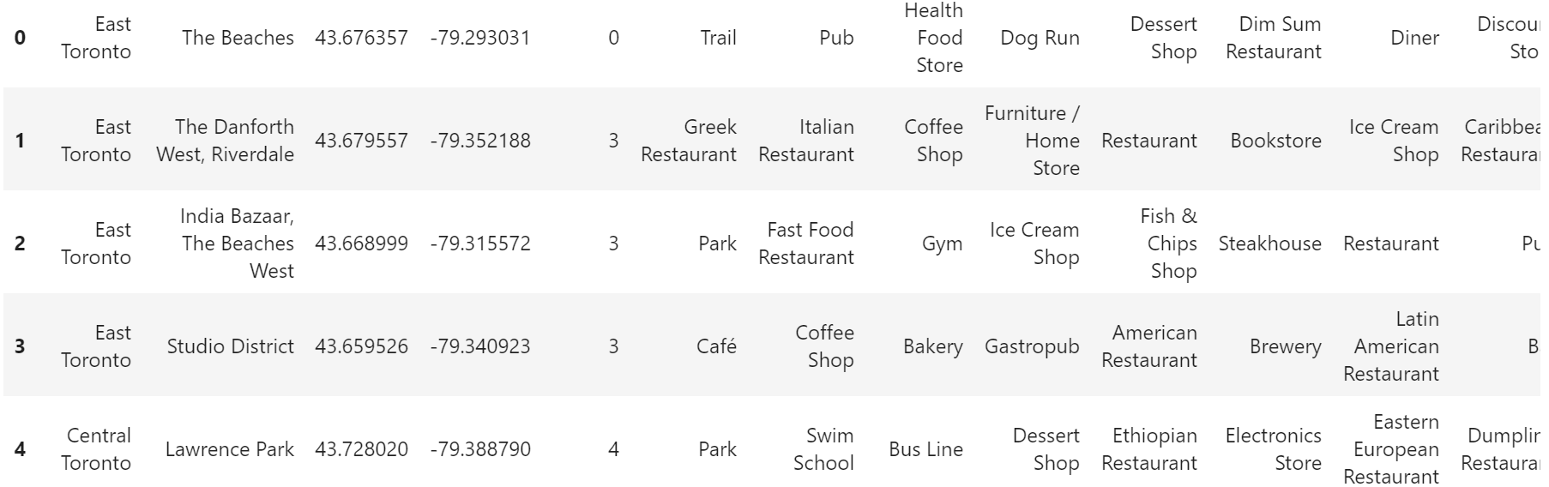
Grouping the results by neighborhood

Slide 9
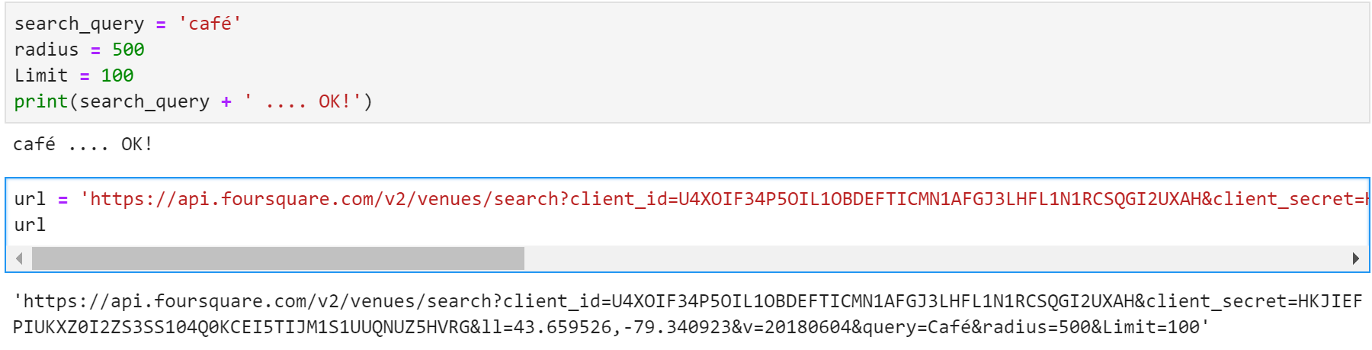
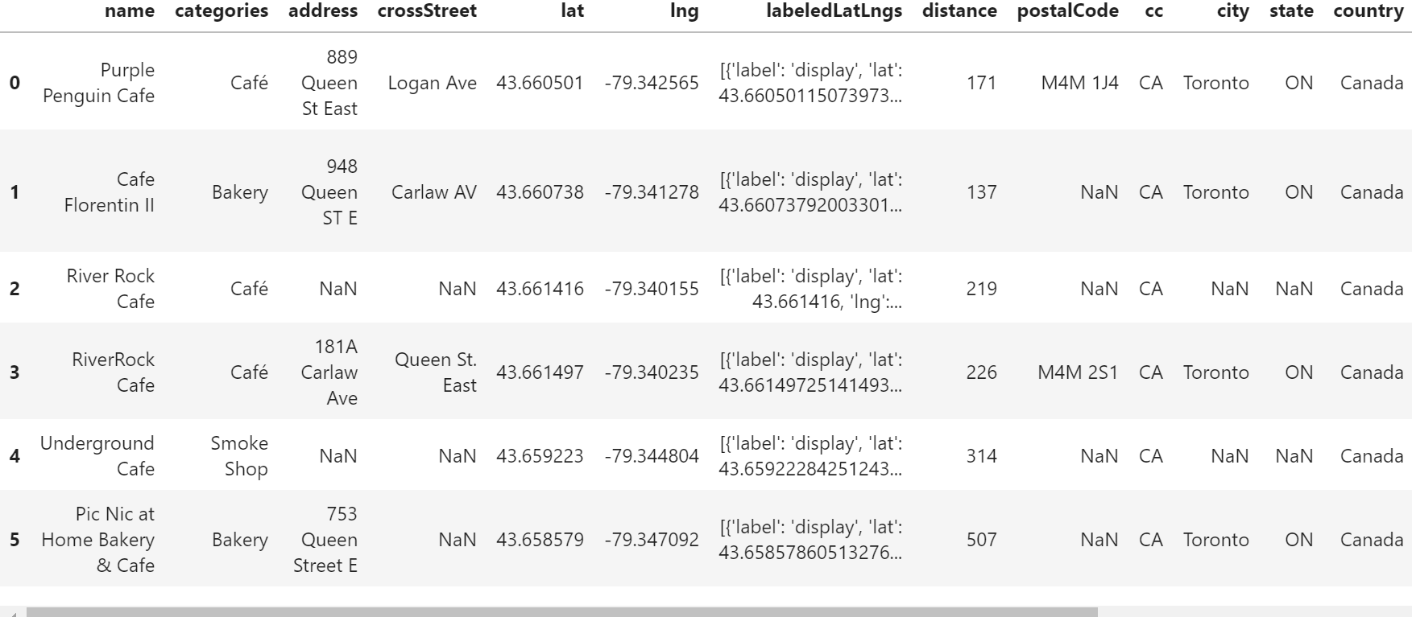
FOURSQUARE API SEARCH
Searching for café in the studio district neighborhood, lots of results
Let’s go to Purple Penguin Café

Slide 10
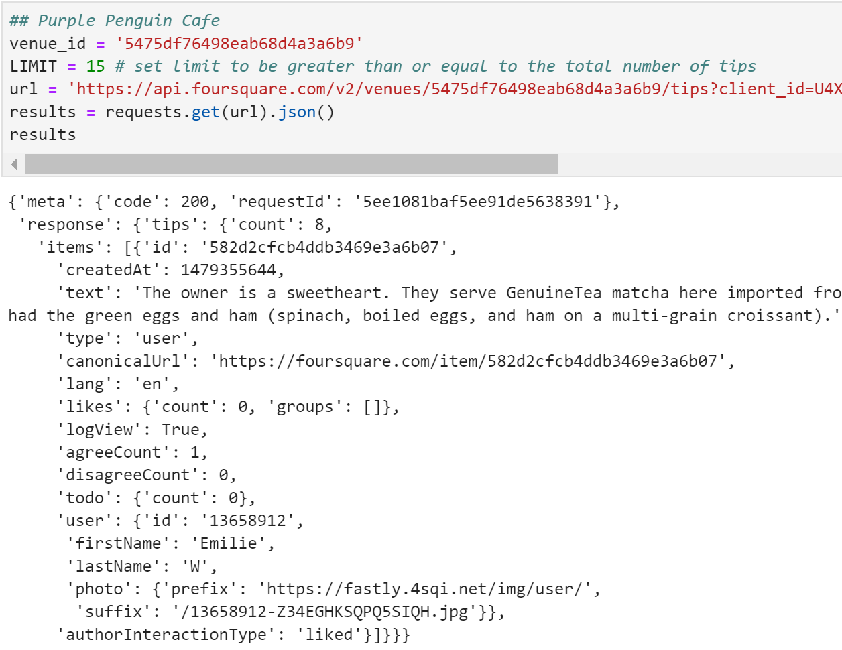
Reviews on foursquare api
Using the Venue Id found in the previous slide, we result for tips given by the customer who visited and reviewed the café
As the 1 tip per venue restriction, review by Emilie was given.
It was a good review!

Slide 11
Moving on to the crime data

Slide 12
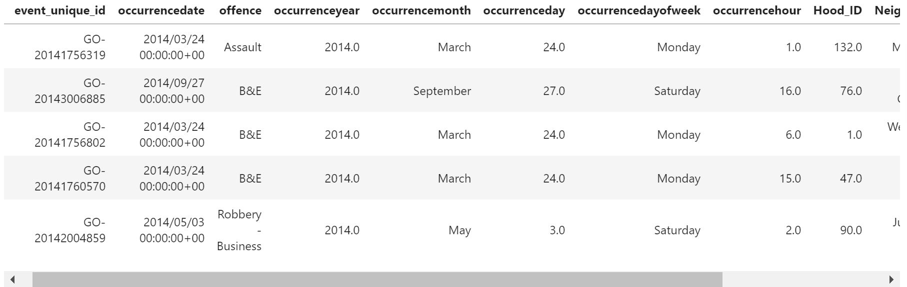
DATA FROM TORONTO POLICE OPEN DATA SOURCE

Slide 13
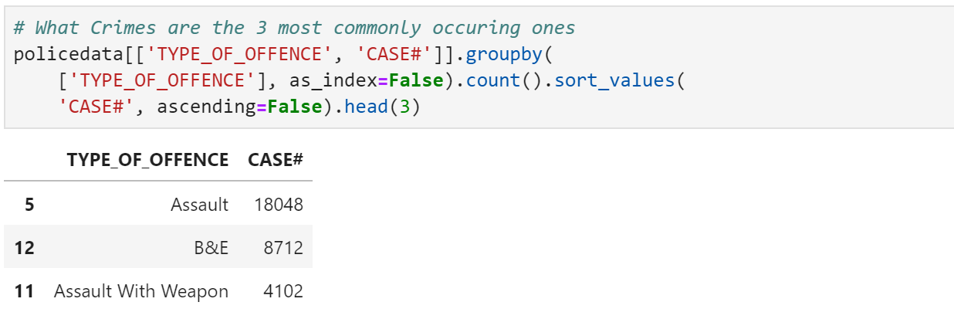
Toronto top 3 crimes

Slide 14
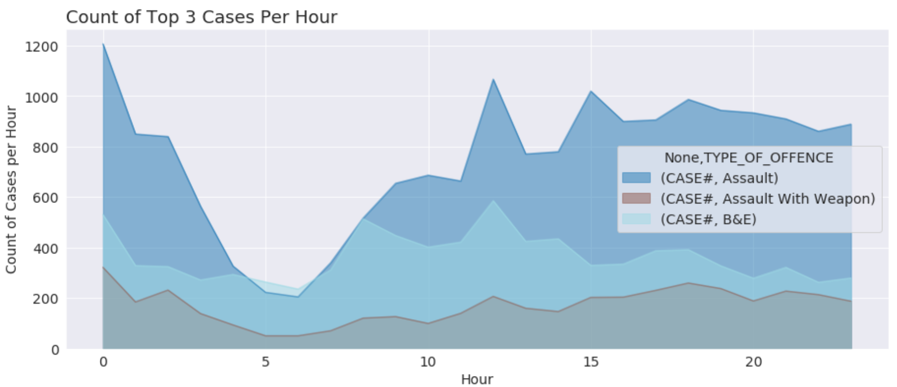
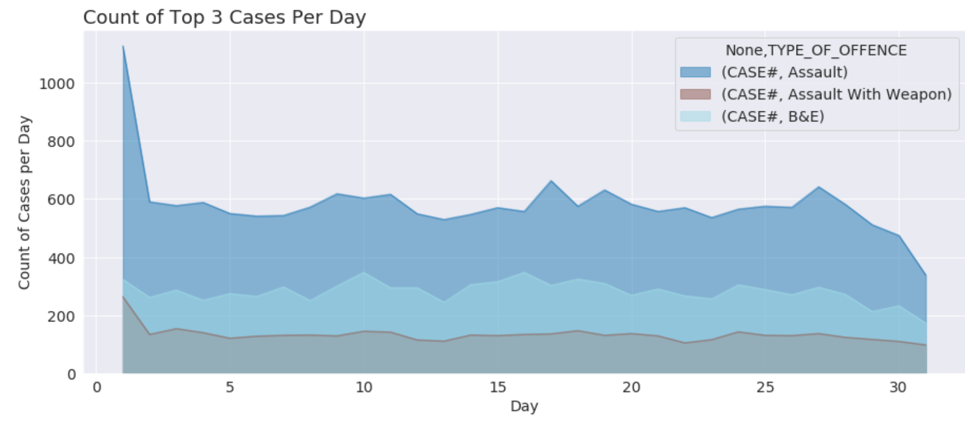
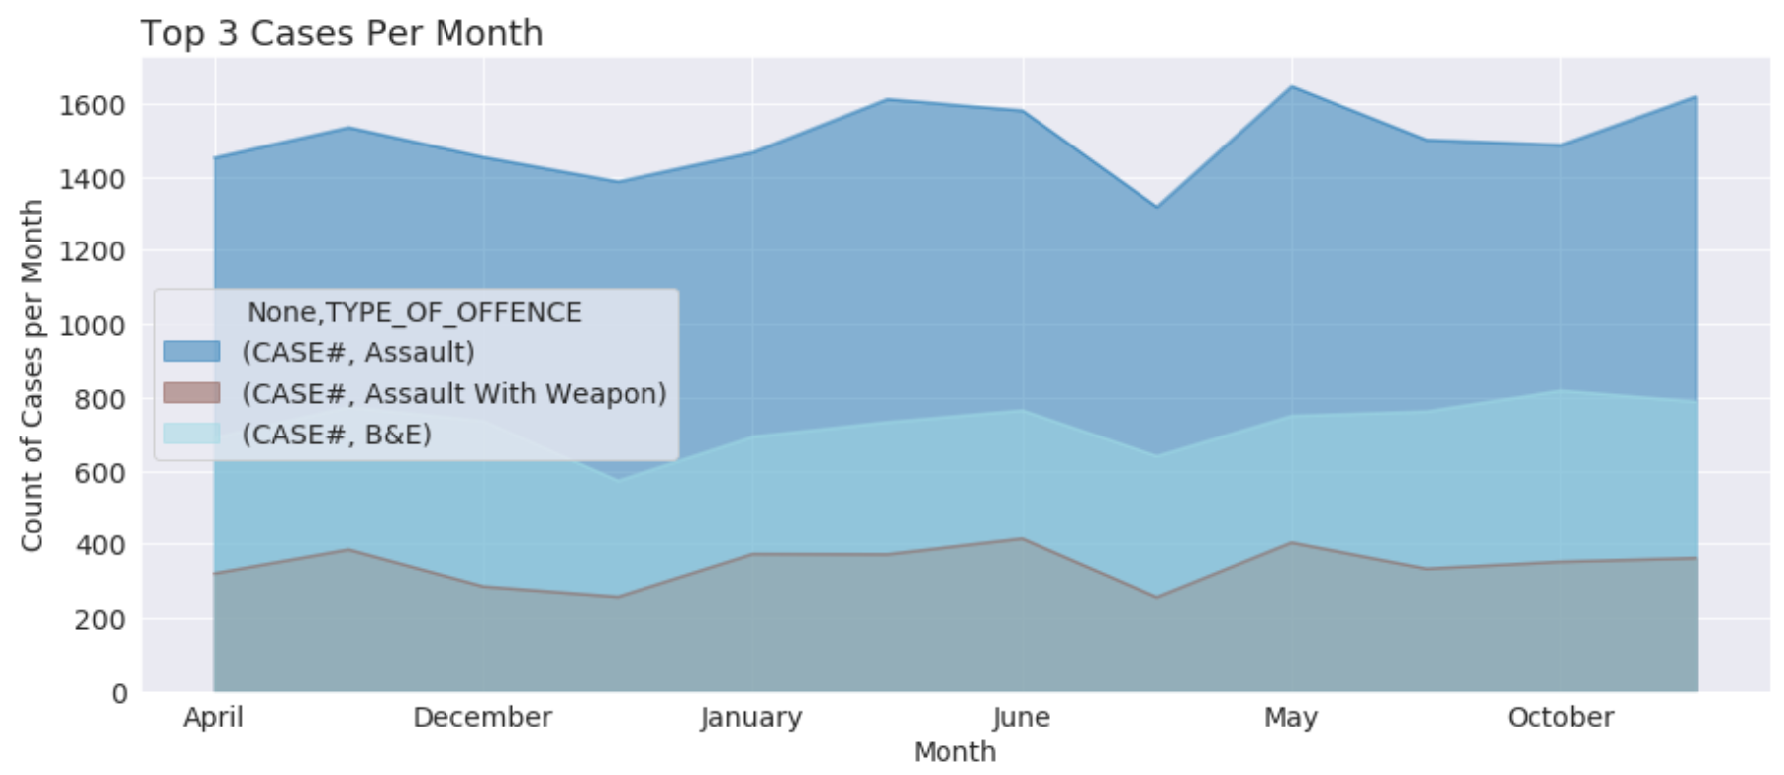
Crime data
With 4 years of data, the chart consistently shows that which hour it will dipped and rise.
Assault crime takes the lead occupying a big area in the chart
During the period around 4am to 6am is the only time where the crime rate is lower
On the first few days of the month, that is where there is a rise in crime recorded

Slide 15
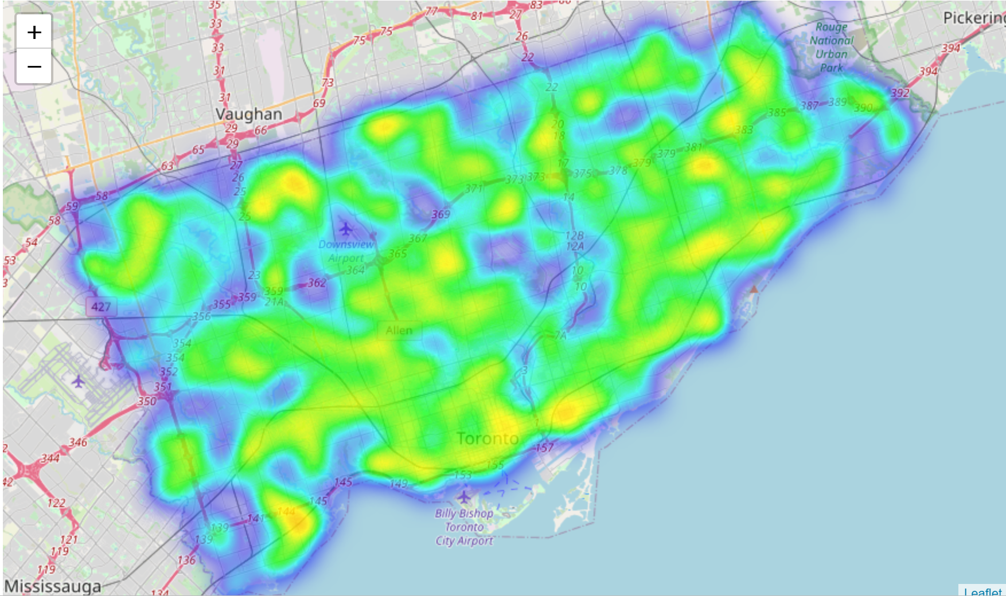
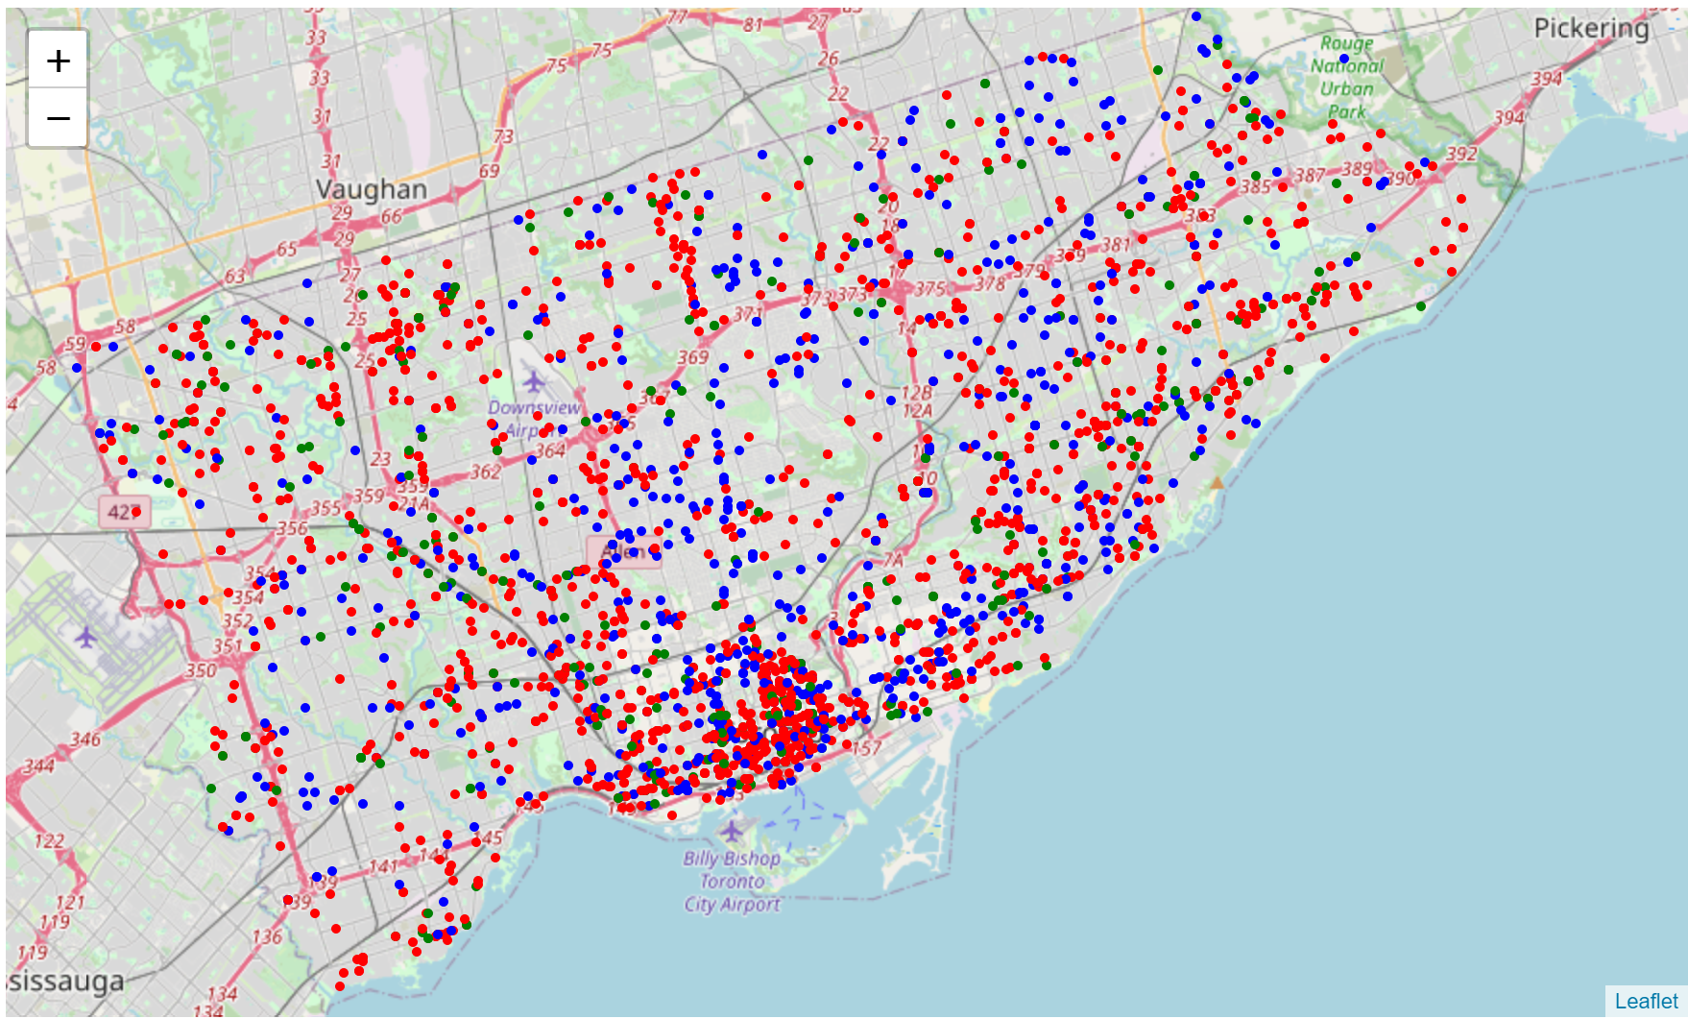
Month of may
Highly scattered around the whole of Toronto
More concentrated around the airport areas and the borders

Slide 16
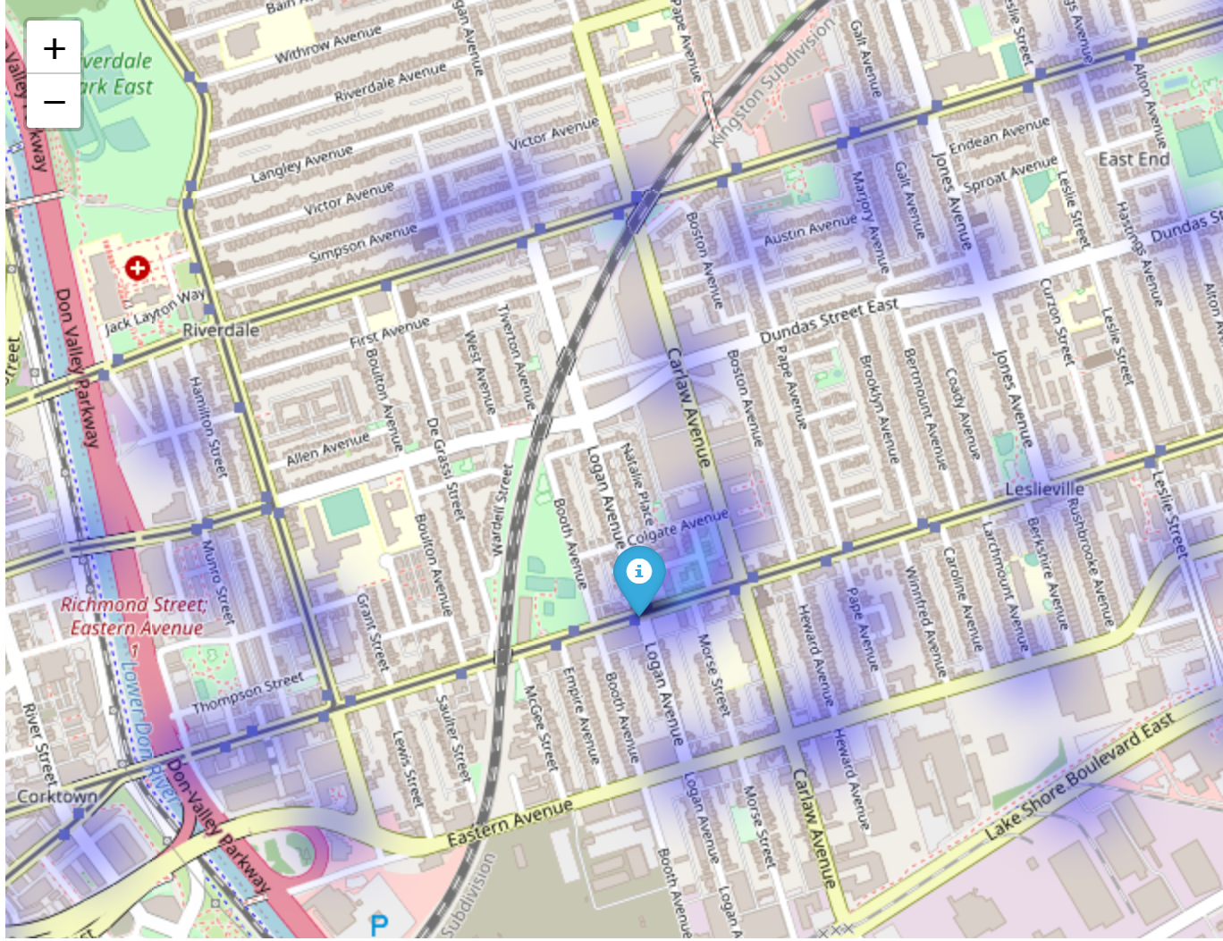
Café location in heat map
What are the crime recorded like around the area
What is needed to be prepared

Slide 17
findings
What we have here is an example of one of the top venues in Toronto. We could do that on all the locations that we want to go so that we can have an overview of the crime recorded in those places.
With this data, the tourist could be better prepared what she is going to face heading to the destination, or even changing the destination because of the crime recorded there is too high. She could also determine what is the best time/day/month to head to the area so that she could feel safer.

Slide 18
improvements
Using Foursquare API is great, but it comes with a downside:
Not all data could be retrieved e.g. Top Picks
Tips are only given one per venue, no overview ( might affect the choice of destination)
I have to declare that the prediction of crime rate happening around the area was clear as the data given by the Toronto police department shows a 4-year data set. The data set shows that in the 4 years, for the month of May, it is quite clear that which time/day/month has a dipped and rise in crimes. There were no ambiguity in the data that shows a flat line. Hence, taking the data as it is, I assume that, if everything else stays the same, the crime data in Toronto would not differ as much.
Not all country provide crime data, might have to think of other way

Slide 19
Conclusion
The idea for the Capstone Project is to show that when driven by venue and location data from Foursquare, backed up with open source crime data, that it is possible to present the cautious and nervous traveller with a list of attractions to visit supplemented with a graphics showing the occurrence of crime in the region of the venue.

